Slide 1
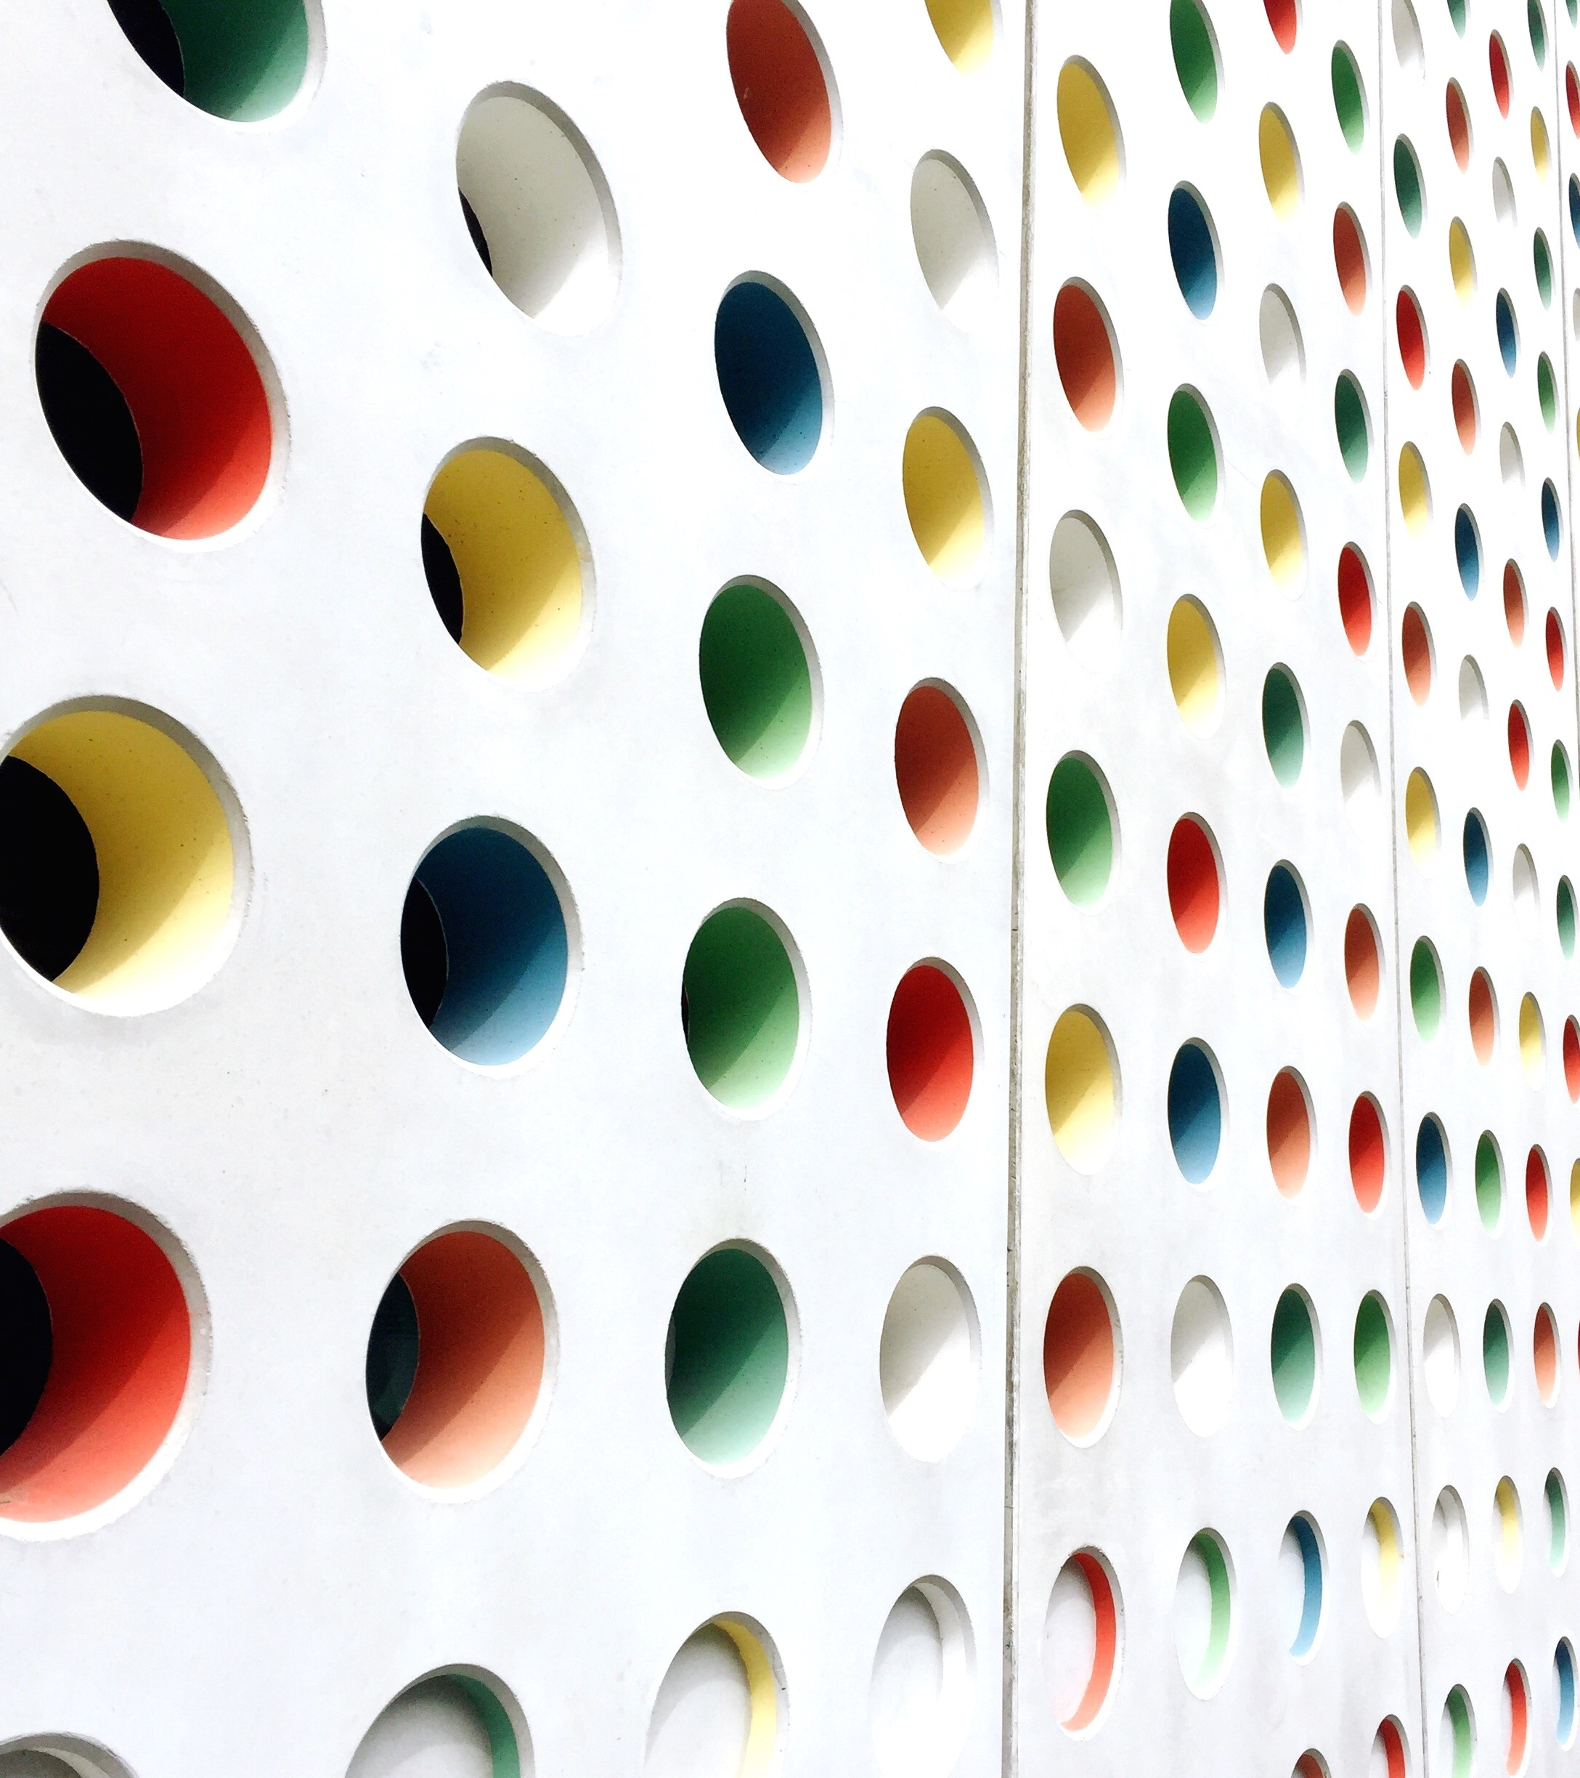
Masters’ Master Mind Paul Radek Anna

Slide 2
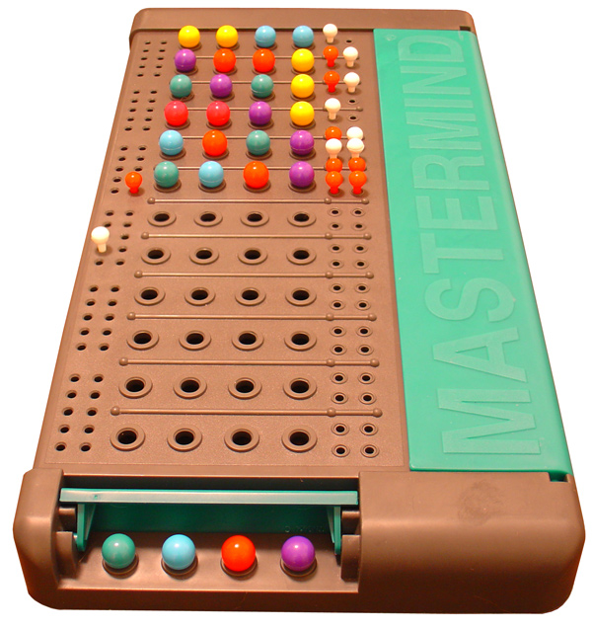
User vs Computer
One player (PC) generates a secret combination of 4 colors
The other player (user) tries to guess the combination
For each guess, the PC gives clues on the right colors and positions
The game stops when the user guesses the right combination
The goal is for the player to guess the secret combination in the least number of trials!

Slide 3
Challenges
Define and plan the different tasks
Split coding parts among members and join them
Restrict user input
Create loops to
continue or quit the game
- Technical difficulties with coding

Slide 4
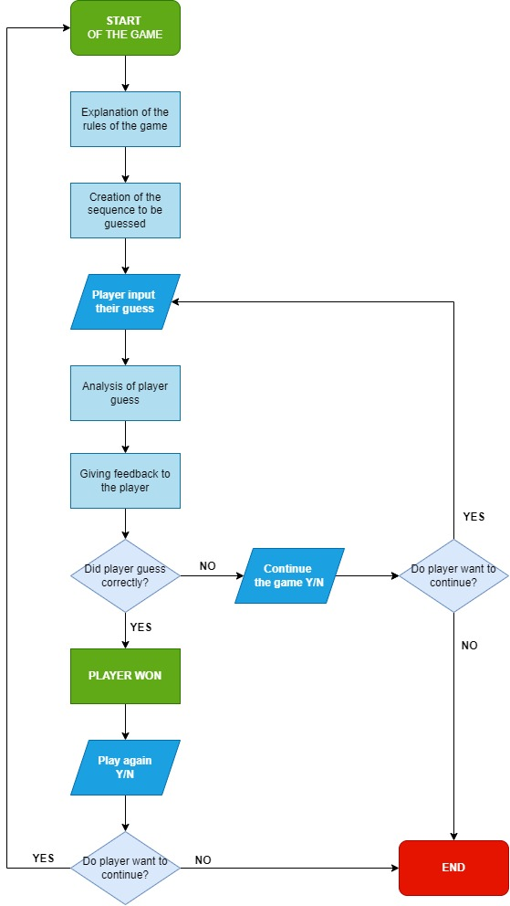
Process
<Our flowchart>

Slide 5
Highlights
Mimic the MasterMind game
Collective & individual inputs

Slide 6
start the game

